Slide 1
CS689A Project Presentation
Submitted by
Abhishek Kumar Pathak (22111002)
Sonam (22111057)
Taneya Soni (22111062)

Slide 2
HMM based Parts of Speech Tagger for Hindi Document

Slide 3
Contents
Objective
Steps of POS Tagging
Source corpore link
List of POS tags
HMM
Viterbi Algorithm
Evaluation
Challenges faced

Slide 4
Objective
AIM
The aim of our project is to assign a specific grammatical class to the input sequence of Hindi and Marathi language.
KEYWORDS
POS tagging, Hindi, Rule-based tagging, HMM Algorithm Viterbi Algorithm

Slide 5
Steps in POS Tagging
Obtain a tagged data set for Training.
Using Hidden Markov Model to identify Transmission and Emission Probabilities.
Apply Viterbi Algorithm on Testing Data Set.
Output the tagging sequence with the highest probability.

Slide 6
The source Corpora, related documentation and credits can be found in below link.
https://universaldependencies.org

Slide 7
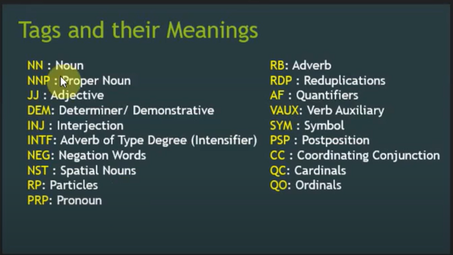
List of POS Tags used

Slide 8
HMM
Hidden Markov Model
Hidden Markov Model can be defined using
a finite set of states. (Here states can be noun(N), verb(V), adjective(A), adverb(AD) etc )
A sequence of observations. (terminals i.e the words in our sentence)
Transition probability defined as the probability of a state “s” appearing right after observing “u” and “v” in the sequence of observations.
Emission probability defined as the probability of making an observation x given that the state was s.

Slide 9
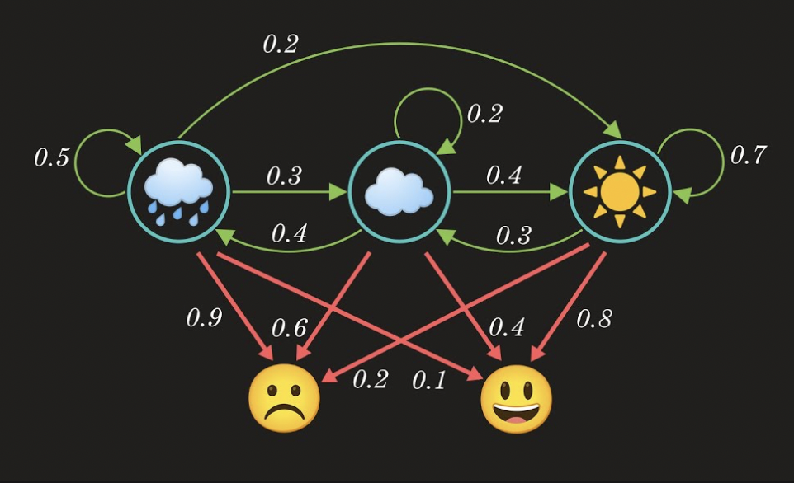
Hidden Markov Model
The states are {rainy, cloudy, sunny}
The observations are {Happy, sad}

Slide 10
HMM
Transition probability
It is the probability that explain the transition to/from hidden states.
Ex- {cloudy-cloudy}=0.5
{cloudy-rainy}=0.4
{cloudy-sunny}=0.2
Emission Probability
Using emission probability we predict hidden states.
‘Rainy’:{ happy: 0.1, sad:0.9}
‘Cloudy’:{happy:0.6, sad:0.4}
‘Sunny’ :{happy :0.8, sad:0.2}

Slide 11
Viterbi Algorithm
…because bruteforce is hopelessly inefficient.

Slide 12
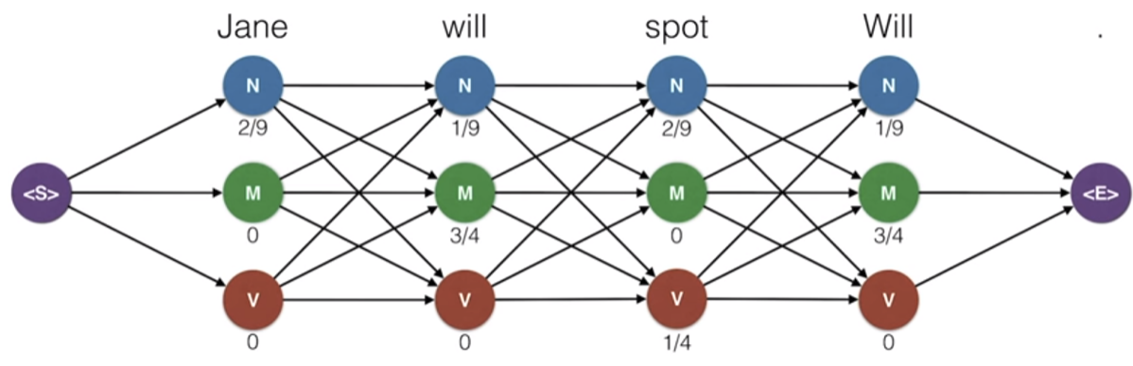
Instead of this brute force approach, we will see that we can find the highest probable tag sequence efficiently using a dynamic programming algorithm known as the Viterbi Algorithm.

Slide 13
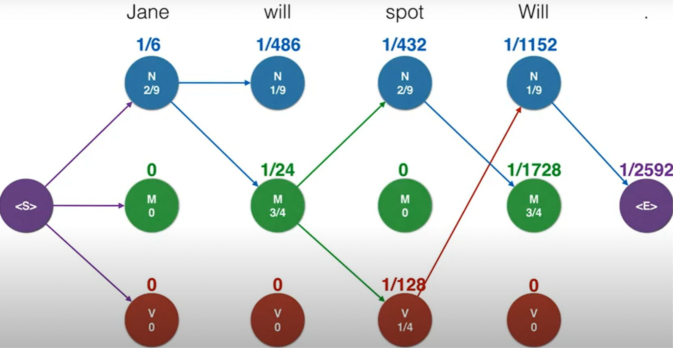
The Viterbi Algorithm will help us by giving the chain of states that generates the observations with the highest probability. Let's say we need to tag the Parts of Speech for the sentence: “Jane will spot Will”. The corresponding probability graph will look like this.

Slide 14
Evaluation of project
Accuracy is the fraction of predictions our model got correct. Here, we can explain the accuracy as “total number of correctly handled words by the presented approach out of total input data.” The range of the accuracy lies between 0 and 100 (in percentage).
Wrong Predictions = 2409
Total Predictions = 35247
Accuracy is = 93.16537577666185 %

Slide 15
Project Demo

Slide 16
Challenges faced
The first challenge was to find POs tagged dataset in hindi.
Cleaning of training and testing data was time talking.
Deciding upon which methodology to use for POS tagging.
Viterbi algorithm was a little tricky at the beginning but it was fun to learn something new.

Slide 17
Timeline
B
Approval of project idea
Finding of POS tagged
train data
Implementation and testing
submission

Slide 18
Thanks!
Open for questions

